Slide 1


Real-Time Face Recognition System with Custom-Trained Deep Learning Models
Graduation Project Presentation
Team Members:
Ahmed Kamal FathAllah (17010210)
George Seleim Abd-Allah Khaleel (20010436)
Supervisors:
Dr. Salah Selim
Dr. Magdy Abdel-Azeem
Computer Science and Engineering Department, Alexandria University

Slide 2
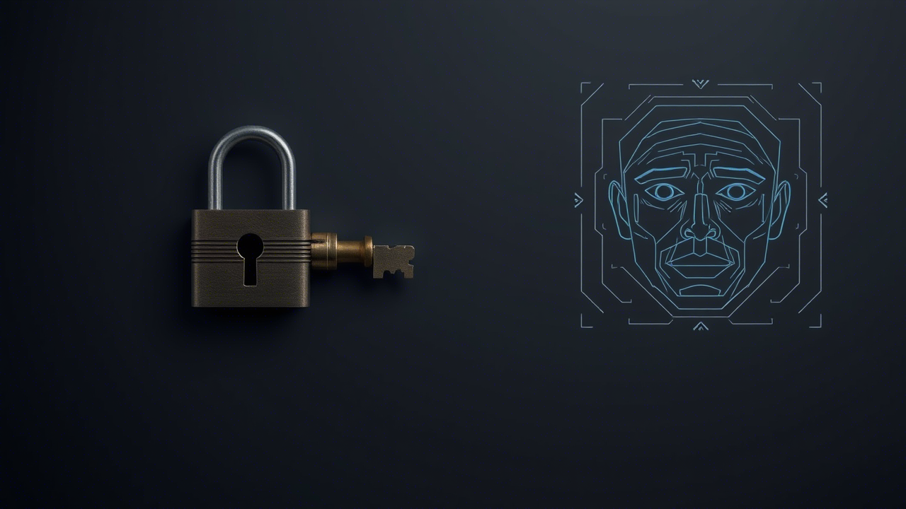
Introduction: The Need for Robust Identity Verification
Growing demand for automated, real-time identity verification in security, access control, and personalized services.
Traditional methods (passwords, ID cards) are often insecure or inefficient.
Facial recognition offers a seamless and non-intrusive solution.
Problem: Off-the-shelf solutions can be rigid and may not perform well under varied conditions (e.g., low-light, poor camera quality).

Slide 3


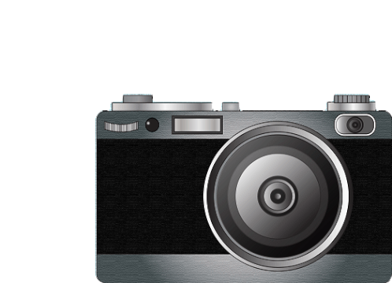

Our Core Objectives
To develop a complete, real-time facial recognition system from the ground up.
To train and integrate custom deep learning models for both face detection and recognition.
To build a flexible system supporting multiple face detection models (YuNet, Haar Cascade, Custom CNN).
To enable support for various camera sources, including built-in webcams and ESP32-CAMs.
To create an intuitive Graphical User Interface (GUI) for easy system management and operation.

Slide 4
High-Level System Architecture
Our system is built on a modular Python architecture, separating core functionalities for maintainability and scalability.
YuNet
Haar Cascade
Custom CNN
Camera Feed (Built-in / ESP32)
Frame Pre-processing (OpenCV)
Face Detection
Face Cropping & Alignment
GUI Output (CustomTkinter)
Database Matching (SQLite)
Embedding Generation (Custom Recognition Model)

Slide 5
System Features
Real-time Performance: Continuous detection and recognition from live video.
Configurable Sources: Easily switch between webcam and IP camera (ESP32).
Multi-Model Support: Dynamically select the best face detector for the task.
User Management: Register new individuals, grant/revoke access, and delete profiles via the GUI.
Robust Recognition: Uses embedding averaging for improved accuracy with fluctuating video quality.
Real-time Feedback: GUI displays live camera feed, recognition results, and match confidence.

Slide 6



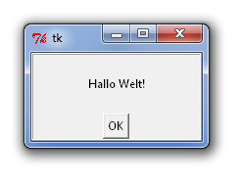


Technologies Used
Python: Core programming language.
PyTorch: For deep learning model training and inference.
OpenCV: For real-time computer vision tasks.
CustomTkinter: For the modern graphical user interface.
SQLite: For lightweight, on-device database management.
NumPy & PIL: For numerical operations and image processing.

Slide 7
Step 1: Finding the Face - Detection Models
Custom CNN:
Architecture: ResNet-based.
Dataset: Trained on CelebA dataset (200k+ images).
Note: Optimized for specific conditions but computationally intensive.
Haar Cascade:
Method: Viola-Jones algorithm.
Benefit: Very fast and lightweight, suitable for resource-constrained systems.
YuNet:
Method: Lightweight deep learning model.
Benefit: Excellent balance of speed and accuracy; our recommended default.

Slide 8
Step 2: Knowing the Face - Embedding Generation
Concept: We convert each face into a unique numerical vector called an "embedding."
Model Architecture: Custom-trained ResNet with residual connections and an ArcFace loss function.
ArcFace Loss: This specialized loss function maximizes the angular distance between different identities in the feature space, leading to highly discriminative embeddings.
Training Dataset: VGGFace2-HQ (large-scale dataset for robust training).
Process: The distance between two embeddings determines similarity. A smaller distance means a higher probability of a match.

Slide 9
Model Training & Evaluation
Face Detection Model (CelebA):
Used the facial-detection-celeba-bbox-optimized.ipynb notebook.
Focused on minimizing bounding box localization error.
Face Recognition Model (VGGFace2):
Used the arkface-residual-connections-part-2 training.ipynb notebook.
Trained with ArcFace loss to create a model that is robust to variations in lighting and pose.
Evaluation: Tested on the PINS Face Recognition dataset, achieving high accuracy.

Slide 10
Model Version | Training Epochs | Learning Rate Schedule Observation | Lowest Validation Loss (Approx.) | Final Validation Accuracy (Approx.) | Key Observations
resarksgd69 | 20 | Step decay, multiple drops | 4.0 | 70% | Steady accuracy increase, but final accuracy is lower compared to other versions.
resarksgd88 | 5 | Sharp drop after 2 epochs | 1.75 | 88% | Achieves decent accuracy in very few epochs, suggesting quick convergence or effective fine-tuning.
resarksgd94 | 13 | Step decay, gradual drops | 0.7 | 92% | Train loss consistently decreases, val loss plateaus. Shows strong learning over more epochs.
resarksgd95 | 2 | Single sharp drop | 0.87 | 95.8% | Extremely high initial validation accuracy, indicating this likely represents a fine-tuning phase of a highly pre-trained model. Very stable validation accuracy.
resarksgdaug94 | 20 | Step decay, gradual drops | 0.1 | 94% | Best overall performance in terms of lowest validation loss and sustained high accuracy, suggesting effectiveness of data augmentation.

Slide 11
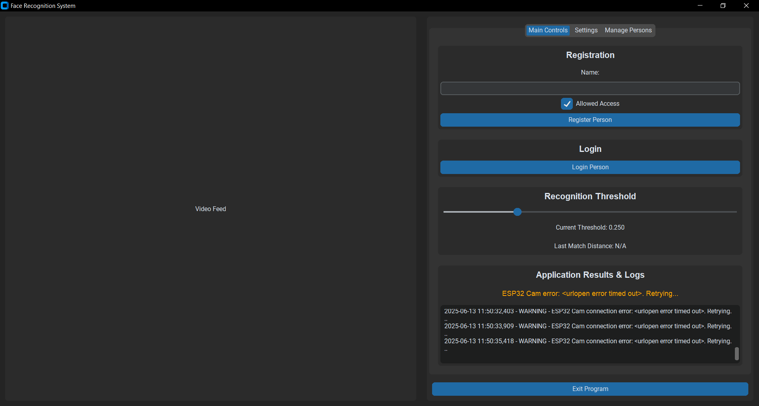
The User Interface: Main Controls
The main tab provides all core operational controls.
Actions: Buttons for "Login Person" and "Register New Person."
Live Feed: Real-time video from the selected camera.
Threshold Slider: Allows dynamic adjustment of recognition sensitivity.
Status & Logs: An area for real-time feedback, including recognition results, match distance, and system messages.

Slide 12
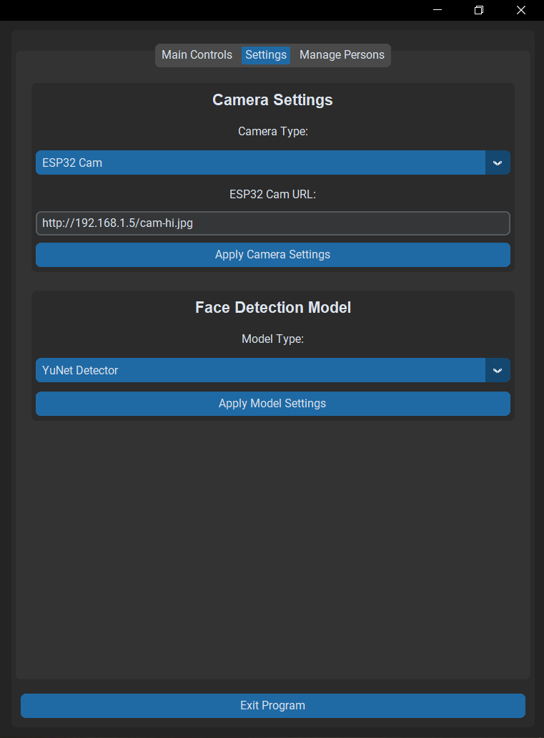
The User Interface: Settings Tab
This tab allows for on-the-fly system configuration.
Camera Selection: Dropdown menu to choose between "Built-in Cam" and "ESP32 Cam."
Apply Buttons: Settings are applied instantly without restarting the application.
Model Selection: Dropdown menu to switch between "YuNet," "Haar Cascade," and "Custom CNN" face detectors.

Slide 13
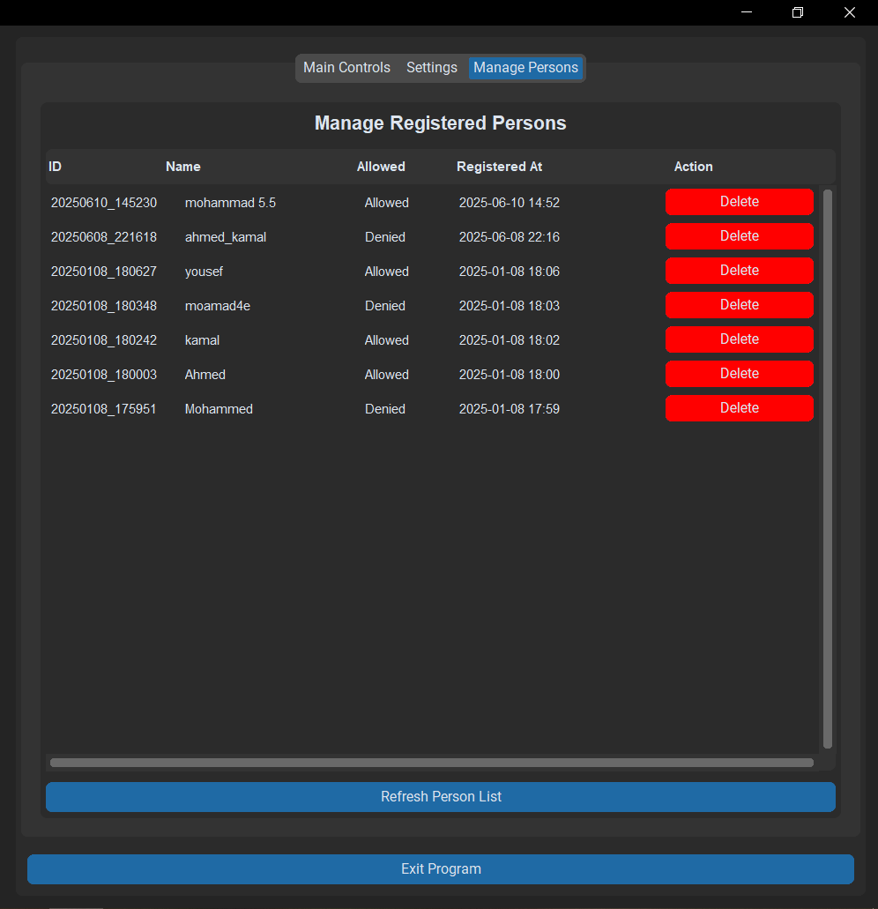
The User Interface: Manage Persons
Provides full control over the user database.
Registered List: Displays all individuals in the database with their name and access status.
Delete Functionality: Easily remove individuals from the system with a single click.
Status Indicator: Clearly shows whether a person is "Allowed" or "Not Allowed."

Slide 14
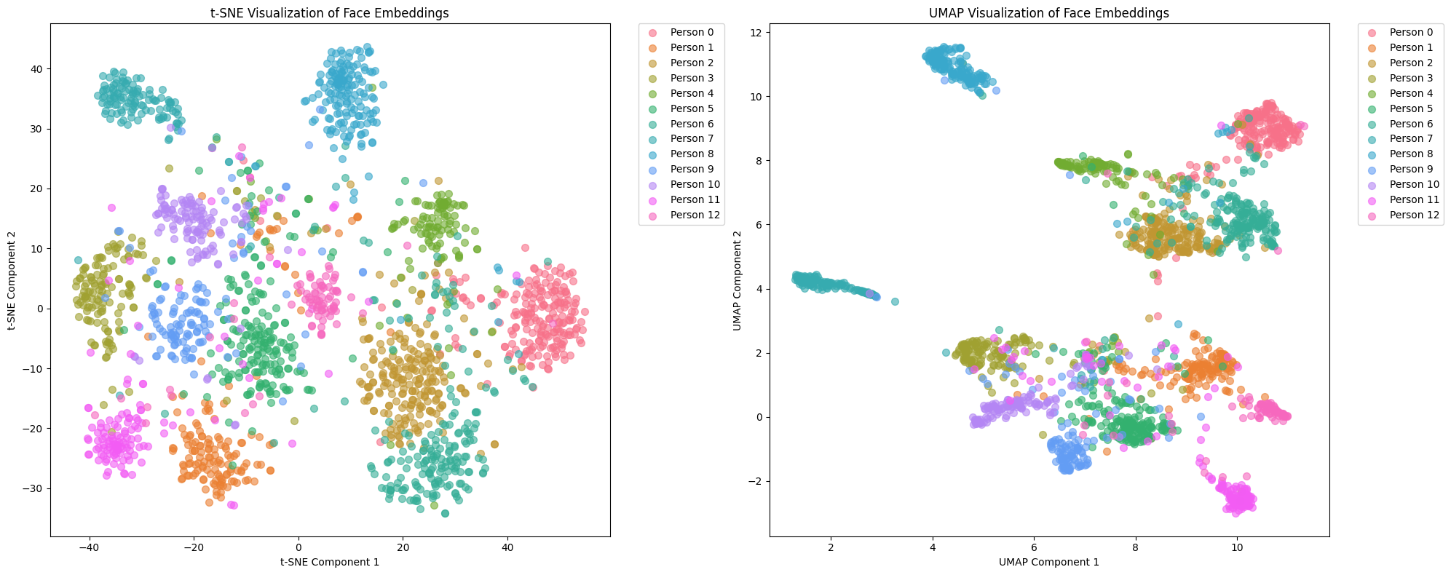
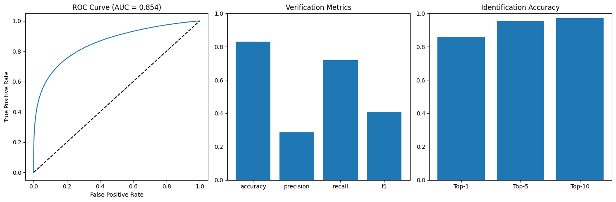
Results & Challenges
Performance: The YuNet detector provided the best real-time balance of speed and accuracy.
Visualization of Embedding Clusters
Recognition Accuracy: The custom recognition model demonstrated good accuracy, especially with embedding averaging up to approximately 20 people.
Flexibility: The modular design successfully allows for easy switching of components (cameras, models).
Challenges:
Handling significant variations in lighting and camera angles.
Optimizing the custom CNN detector for real-time performance.
Ensuring thread-safe database operations to prevent GUI freezing.
Model Verification & Identification Performance

Slide 15
Conclusion
Successfully developed a robust, flexible, and user-friendly real-time facial recognition system.
Demonstrated the effectiveness of custom-trained deep learning models for specific tasks.
The modular architecture provides a strong foundation for future development and expansion.
The project successfully met all initial objectives.

Slide 16
Future Work
Performance Optimization: Implement GPU acceleration (CUDA) for faster inference.
Model Expansion: Add support for other state-of-the-art models (e.g., RetinaFace for detection).
Liveness Detection: Incorporate anti-spoofing mechanisms to prevent attacks using photos or videos.
Cloud Integration: Connect the database to a cloud service for multi-device synchronization.
Deployment: Package the application into a standalone executable for easier distribution.

Slide 17
Thank You

